Slide 1
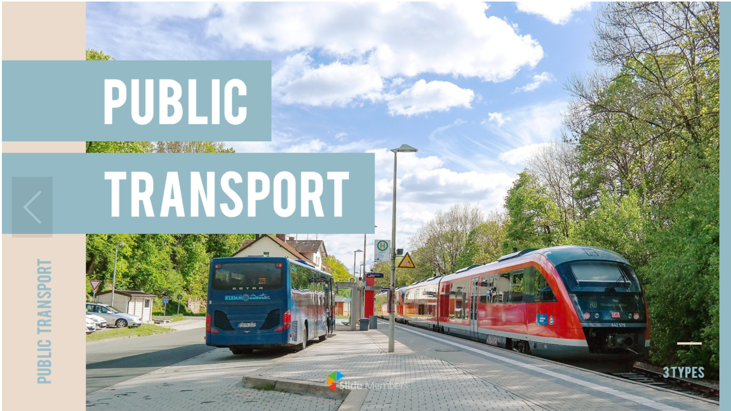
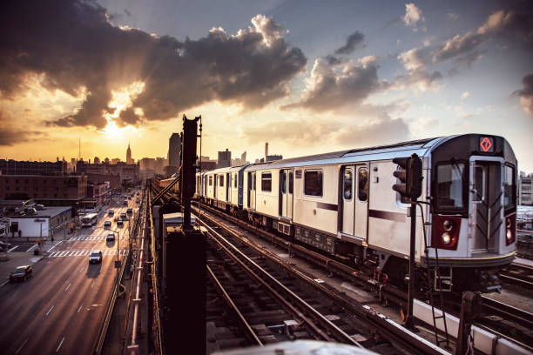

Slide 3

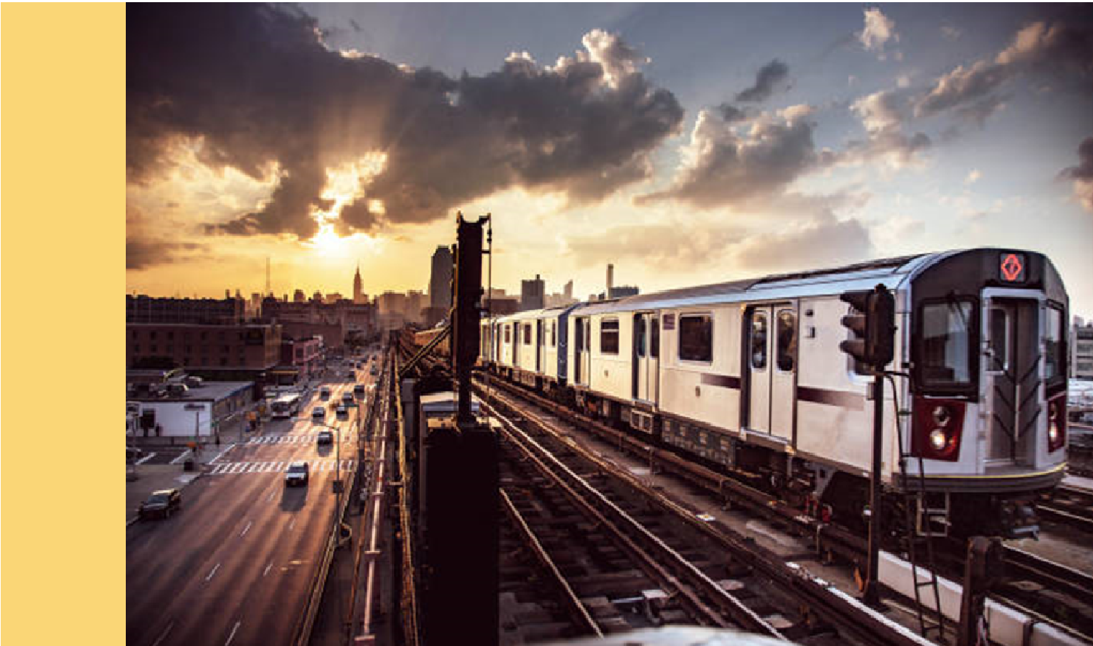

PUBLIC TRANSPORTATION
PUBLIC
TRANSPORTATION

Slide 4
PUBLIC

Slide 5


Slide 6

WHY
PUBLIC
TRANSPORTATION?
Public transportation provides
opportunity, access, choice and freedom,
all of which contributes to an improved
quality of life.
Visiting major cities in the US has
shown me that Nashville could do better.
I want to know why Nashville is not providing
the same quality of service as
other cities.

Slide 7
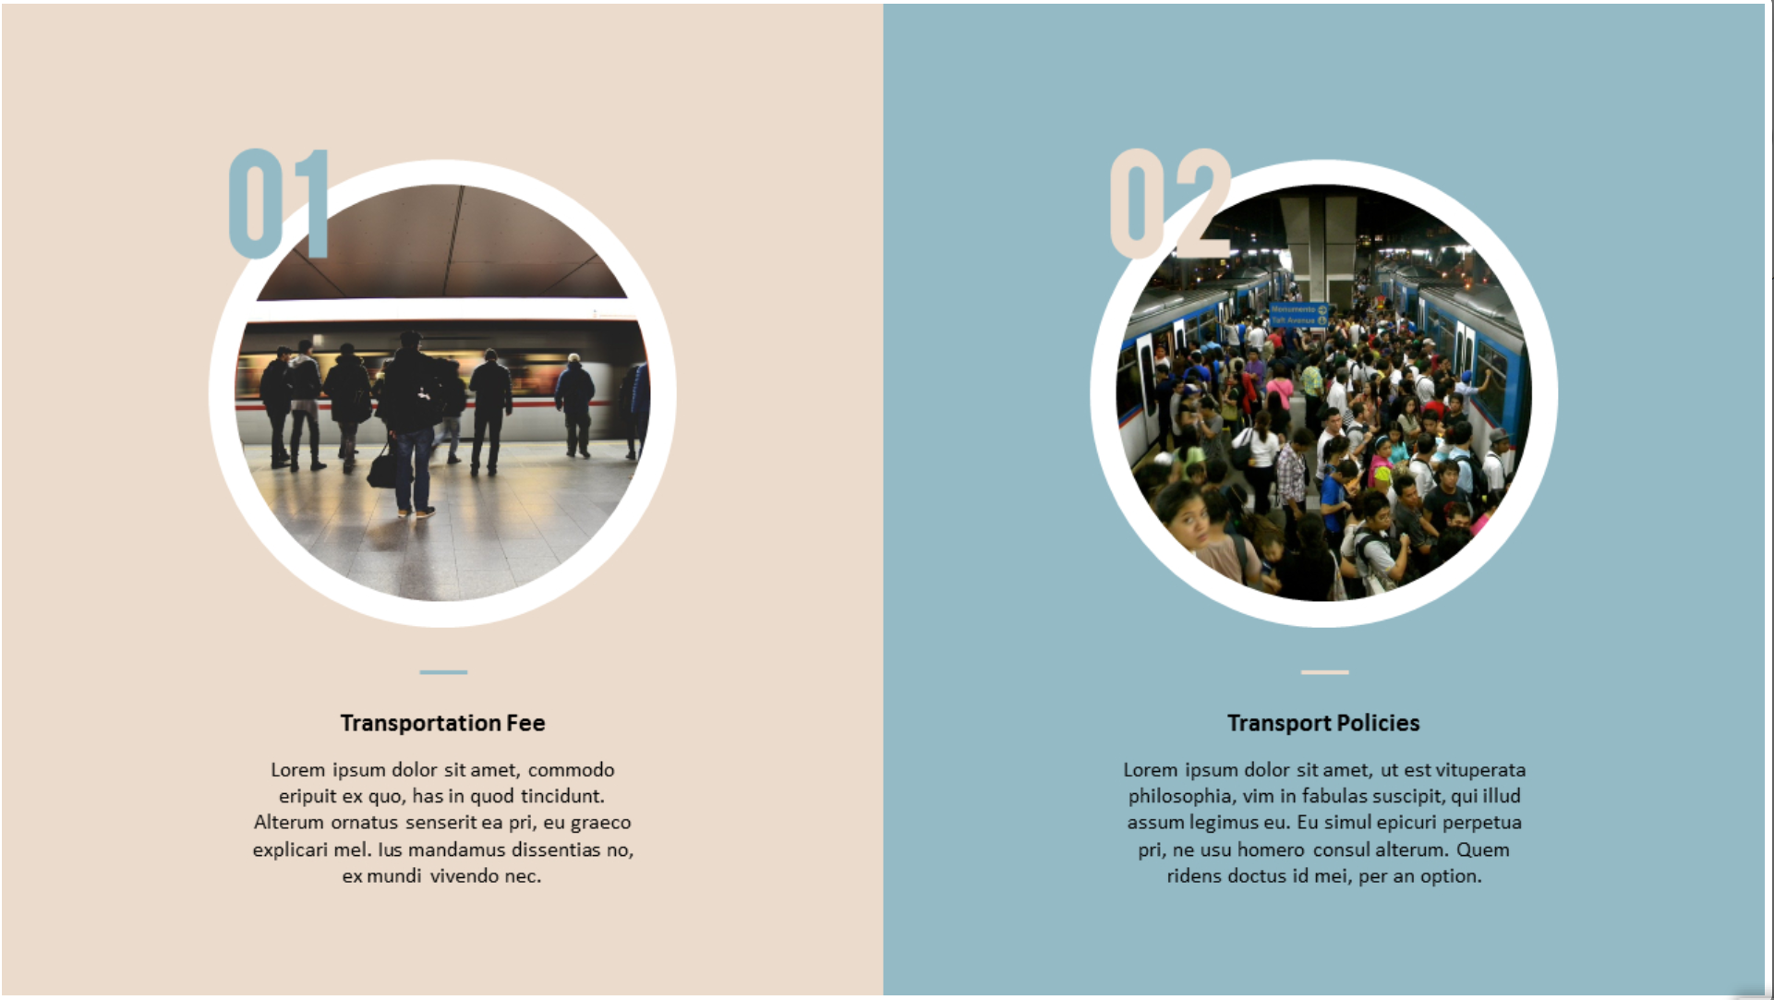
THE FOUR CITYIES THAT I’LL BE COMPARING and their size, population, density.

Slide 8
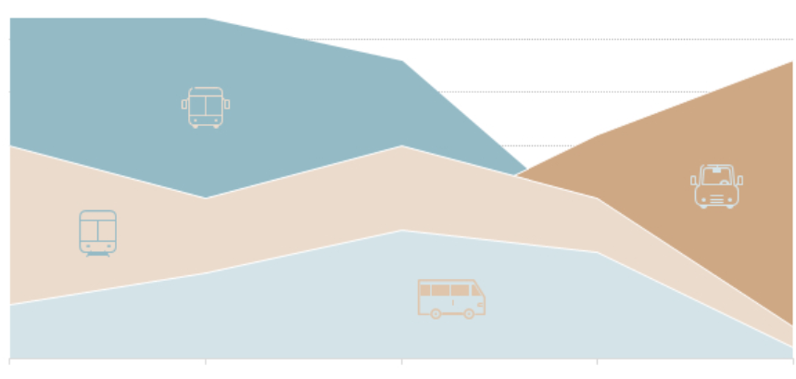

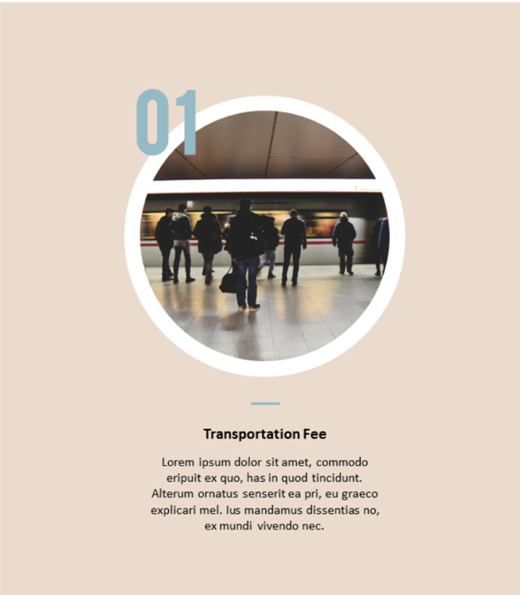
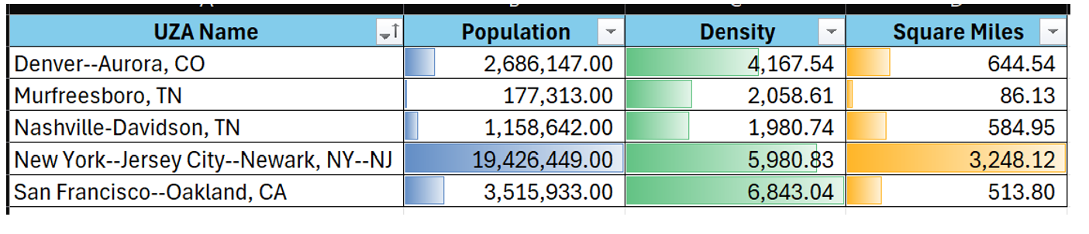
New York City, NY
Population Served: 19,426,449
Square Miles: 3.248.12
Density: 5,980.83

Slide 9
New York City, NY
Population Served: 19,426,449
Square Miles: 3.248.12
Density: 5,980.83

Slide 10

New York City, NY
San Francisco, CA
Population Served: 19,426,449
Square Miles: 3.248.12
Density: 5,980.83
Population Served: 3,515,933
Square Miles: 513.80
Density: 6,843.04

Slide 11

Denver, CO
New York City, NY
Population Served: 2,686,147
Square Miles: 644.54
Density: 4,167.54
Population Served: 19,426,449
Square Miles: 3.248.12
Density: 5,980.83

Slide 12
Denver, CO
Population Served: 2,686,147
Square Miles: 644.54
Density: 4,167.54

Slide 13

Nashville, TN
Population Served: 1,158,642
Square Miles: 584.95
Density: 1,980.74

Slide 14
New York City, NY
Nashville, TN
Population Served: 19,426,449
Square Miles: 3.248.12
Density: 5,980.83
Population Served: 1,158,642
Square Miles: 584.95
Density: 1,980.74

Slide 15
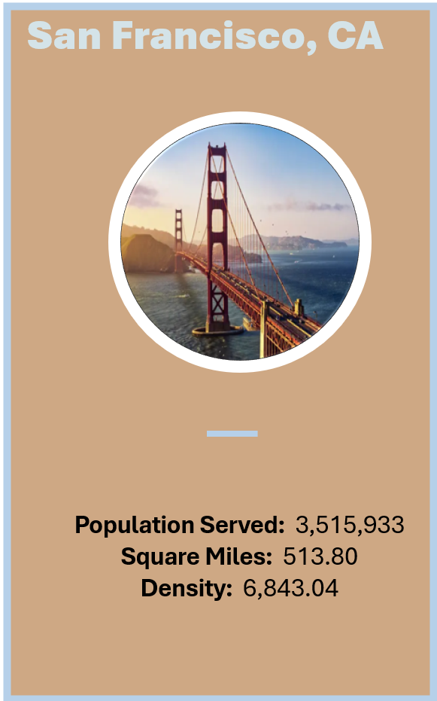
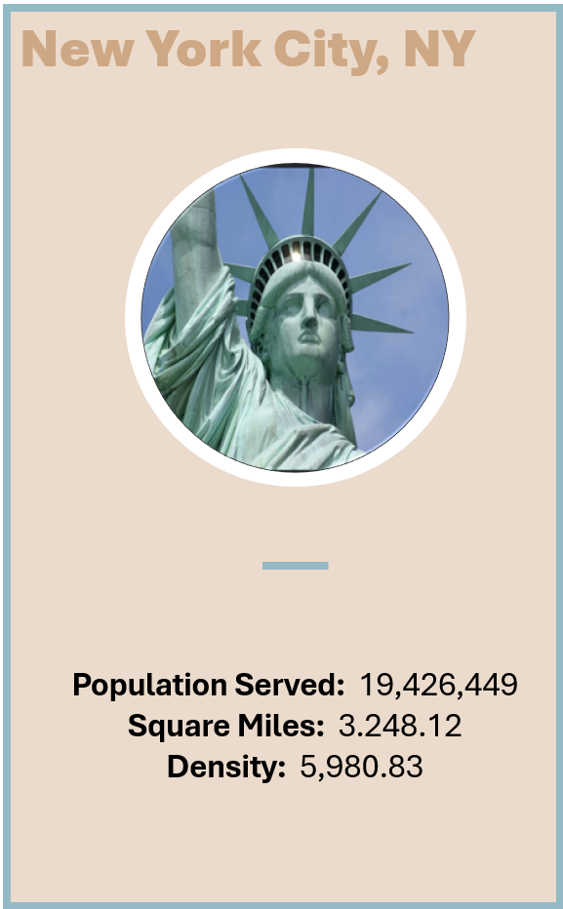
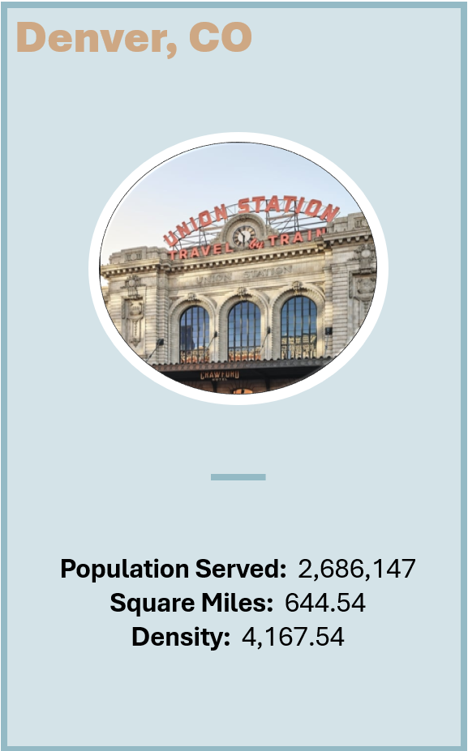
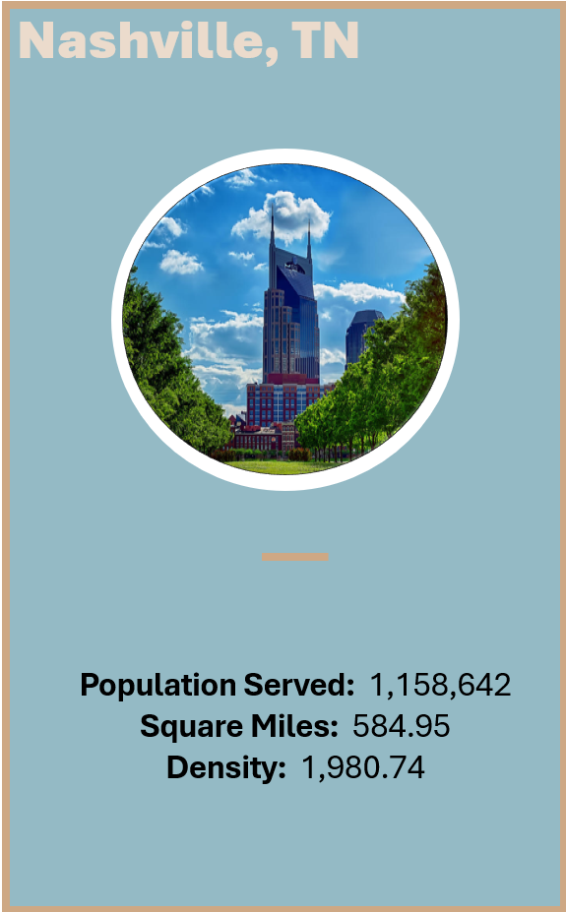

Slide 18
SLIDES

Slide 19


Slide 20


Slide 21
Density allows the data to be normalized across the four states even though the population and square miles are so different.
DENSITY

Slide 23

THE TERMS THAT I’LL BE USING TO COMPARE

Slide 24
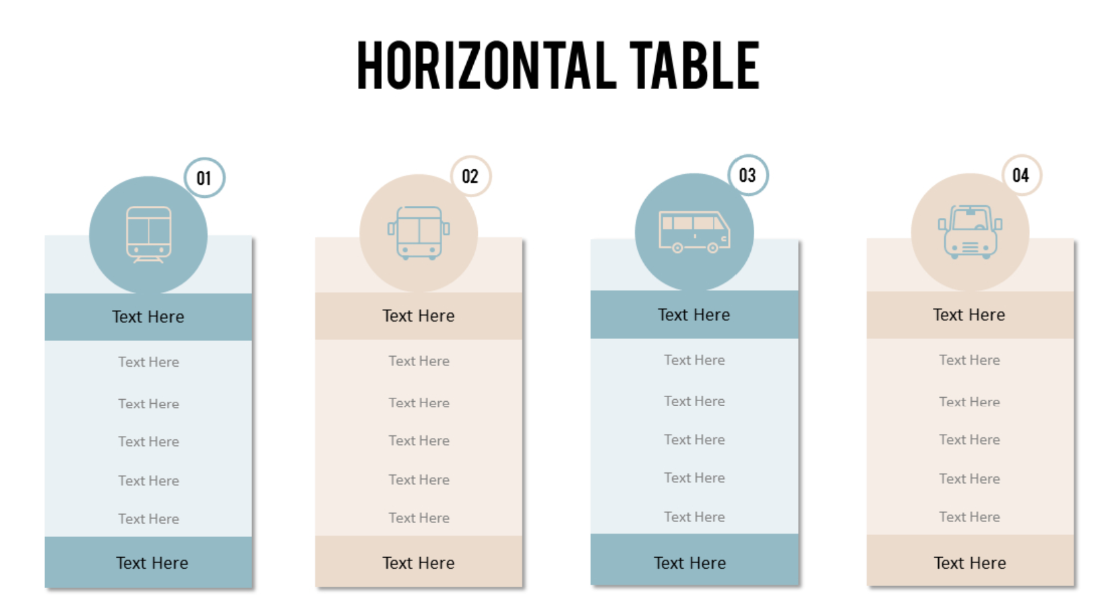
COMPARE OPERATING EXPENSES, MILES, HOURS, TRIPS

Slide 25
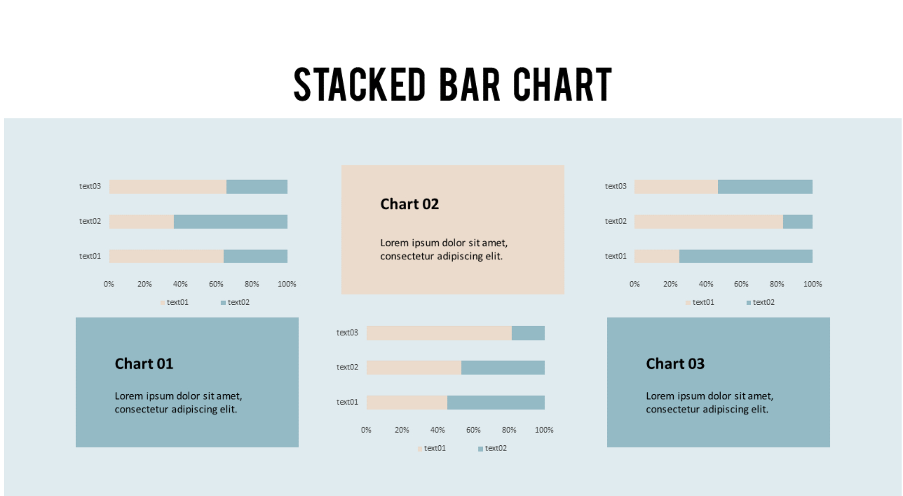
KPI’S: trip, mile, expense, per density/capita.

